Slide 1


investment portfolio optimization
PREPARED BY: SRIJANA BHUSAL

Slide 2

Table of Content
01
Preliminary Work
Introduction to stocks, sectors and risk groups
02
LP Optimization Models
Conceptual diagram, algebraic formulation, optimal solution, sensitivity analysis, interpretation and suggestions
03
ILP Optimization Models
Agebraic formulation, optimal solution, interpretation and suggestions
04
Optimization Results and Recommended Strategies
Summary table with model comparisons, preferred strategy and rationale

Slide 3

01. Preliminary Work
Health Care Sector
Technology Sector
Communication Sector
Financials Sector
Pro Medicus (PME)
Telstra (TLS)
Commonwealth
(CBA)
Xero (XRO)
Cochlear (COH)
RPMGroups ( RUL)
Superloop (SLC)
Suncorp (SUN)
Stock Selection basis:
4 Different Sectors to diversify Portfolio
2 Stocks from each Groups

Slide 4
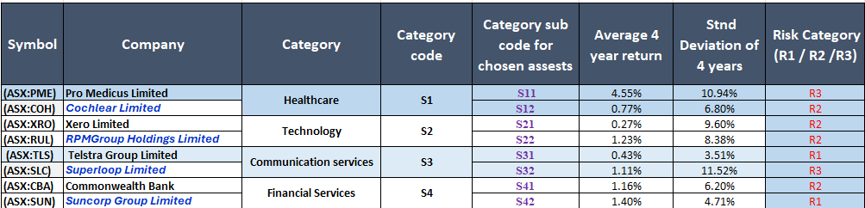
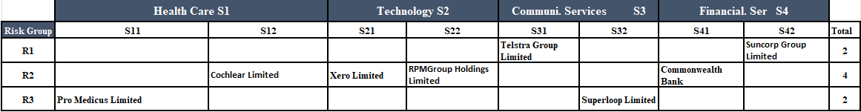
Return and Risk
R1 < R2 < R3 based on standard deviation (SD),
R1= Sd < 5%
R2 = 5% < SD <10%
R3 = 10% < SD
Risk Group Categorization

Slide 5




02. LP Conceptual Diagram
0.046
0.008
0.140.003
0.012
0.004
0.011
0.012
0.014
S11
S12
S21
S22
S31
S32
S41
S42
<=
15% of portfolio
<=
20% of portfolio
<=
15% of portfolio
S1
S2
S3
S4
Asset Return
<=
15% of portfolio
SECTOR
Asset Allocated
RISK CATEGORY
Maximize Return
R1
R2
R3
>
<=
R1 + R2
15% of portfolio

Slide 6
LP Algebraic Formulation
LP Portfolio Mix
The objective is to achieve the maximum overall return, by maximizing return
Maximizing Return R=∑(Return(i)​⋅Investment(i))
Maximize R=0.046S11+0.008S12+0.003S21+0.012S22+0.004S31+0.011S32+0.012S41+0.014S42
Subject to:
1. Investment in the high-risk assets shouldn’t exceed 15% of the portfolio
R3 (High Risk ≤ 15%)
S11+S32≤0.15
2. The lowest-risk assets should receive the highest allocation of investments compared to all other risk categories
R1 (Lowest Risk ≥ R2, R3)
S31+S42≥S11+S32
S31+S42≥S12+S21+S22+S41
3. Each sector must have a minimum of 15% invested, one sector that you choose (Technology) to have a minimum of 20% invested
S1, S3, S4 >= 0.15, S2>=0.20
S11+S12 >=0.15
S31+S32>=0.15
S41+S42>=0.15
S21+S22>=0.20
4. minimum investment in each asset should be 5%
Sij >=0.05, (i=1,2, j=1,2)
S11 >=0.05, S12 >=0.05, S21 >=0.05, S22 >=0.05, S31 >=0.05, S32 >=0.05, S41 >=0.05, S42 >=0.05
5. Any sector cannot exceed 40%
S11+S12 <=0.4
S21+S22 <=0.4
S31+S32 <=0.4
S41+S42 <=0.4
6. Total investement = 100%
S11+S12+S21+S22+S31+S32+S41+S42 = 1

Slide 7
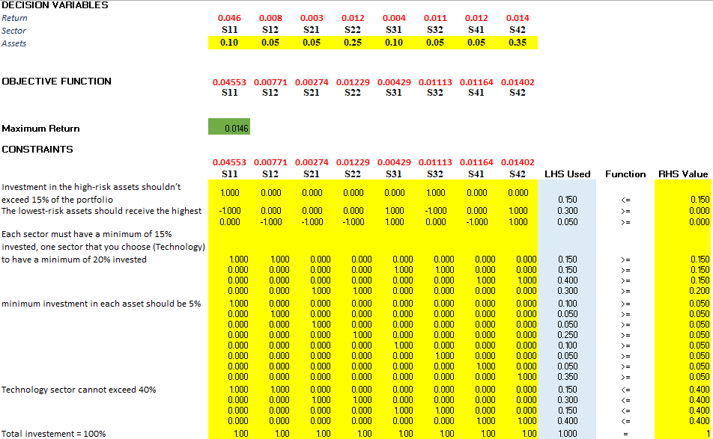
Optimal Solution

Slide 8
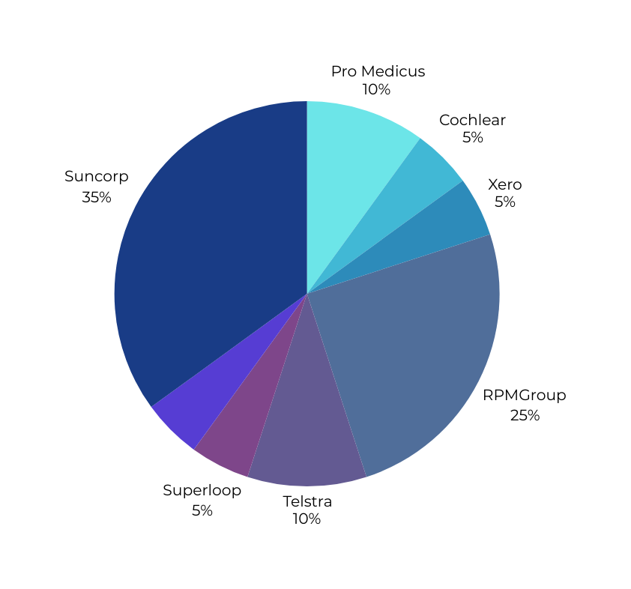
Optimal Solution
Return: 1.46%

Slide 9
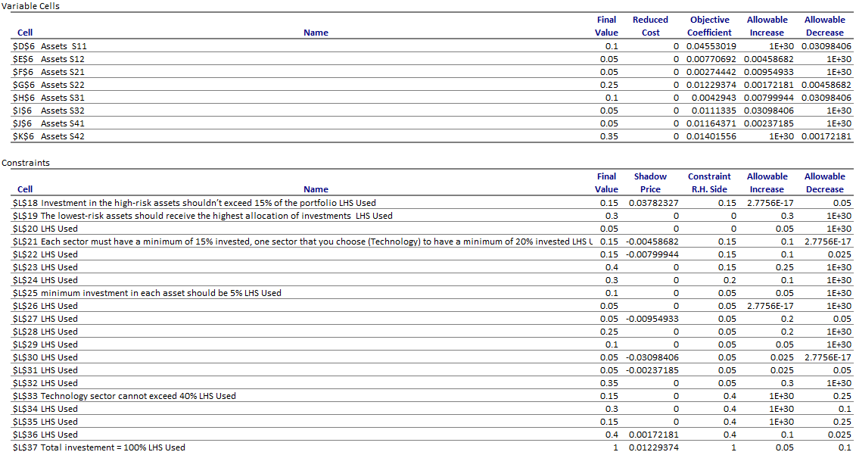
Sensitivity Analysis

Slide 10
Sensitivity Analysis
Binding Constraints
High-risk asset cap (15%) is binding; limits allocation to high-return assets.
Sector 1 & 2 minimums (15%) are binding; restrict flexibility.
Minimum asset allocation (5%) forces investment in lower-performing assets.
Reduced Cost
All selected assets have reduced cost = 0 → optimal portfolio inclusion.
Non-zero reduced cost (not observed) would indicate suboptimal investment.
Shadow Prices
High-risk cap: +0.0378 → loosening increases return significantly.
Sector 1 & 2 minimums: Negative values → reducing them improves return.
Technology sector cap (40%): Slightly binding; raising it boosts return slightly.
Total investment constraint: Fully utilized; positive return contribution.
Impact of changing risk and sector constraints
Relaxing risk cap → higher returns, more volatility.
Lowering sector minimums → reallocates to better-performing assets.
Increasing Tech cap → minor return gains.
Over-constraining sectors can suppress overall performance.
Cost Reduction Strategies
Reduce underperforming sector minimums (e.g., Sector 1, 2).
Slightly increase high-risk cap (e.g., from 15% to 20%).
Avoid minimum investments in low-return assets.
Balance flexibility with policy goals in sector allocation.

Slide 11
Interpretation and Suggestions
01
Interpretation
Objective Achieved: The model maximized return to 0.0146, allocating investments optimally across 8 ASX-listed assets.
Asset Allocation:
Highest investment: ASX:SUN (35%), aligned with high return (0.014).
Lowest investments (5%): ASX:S12, S21, S32, S41—either lower return or constraint-limited.
Constraints Impact:
High-risk cap (S11 + S32 ≤ 15%) is fully utilized—binding constraint.
Sector minimums and individual asset minimums are mostly just met, suggesting tight constraint pressure.
Technology sector (S2) met the higher 20% minimum and stayed within the 40% cap.
Risk Preference Reflected: Higher investments in low- to moderate-risk assets (e.g., CBA, SUN) support stable return.
Suggestions
02
Relax high-risk cap (currently binding at 15%):
Slight increase (e.g., to 18%) could allow more investment in high-return PME (S11), boosting overall return.
Loosen sector minimums slightly:
Sectors like S1 and S3 have assets with relatively lower return. Reducing their minimums can free capital for higher-performing sectors.
Revisit 5% per-asset minimum:
Some low-return assets (e.g., XRO/S21 at 0.003) are held due to minimums; relaxing this allows for better yield-focused allocation.
Review sector grouping logic:
Technology is capped at 40% and sits at 30%. If relaxed, could accommodate more of RUL (S22) which has a decent return (0.012).
Re-optimizing quarterly:
Given market volatility, periodic updates to the model can sustain optimal performance over time.

Slide 12
ILP Algebraic Formulation
ILP Portfolio Mix
The objective is to achieve the maximum overall return, by maximizing return
Maximizing Return R=∑(Return(i)​⋅Investment(i))
Maximize R=0.046S11+0.008S12+0.003S21+0.012S22+0.004S31+0.011S32+0.012S41+0.014S42
Subject to:
1. Exactly 5 stocks must be chosen
S11+S12+S21+S22+S31+S32+S41+S42 = 5
2. 4 investment sector must be selected
S11+S12 >=1
S21+S22 >=1
S31+S32 >=1
S41+S42 >=1
3. At most 1 stock can be in the riskiest group
S11+S32 <=1
4. At least 2 must be in the least risky group
S31+S42 >=2
5. An asset from R3 can be selected if an asset from R2 is selected
S11+S32-S12-S21-S22-S41 <= 0
6. Least and moderate risk groups should comprise at least 75% of the portfolio
S12+S21+S22+S31+S41+S42 >=0.75

Slide 13
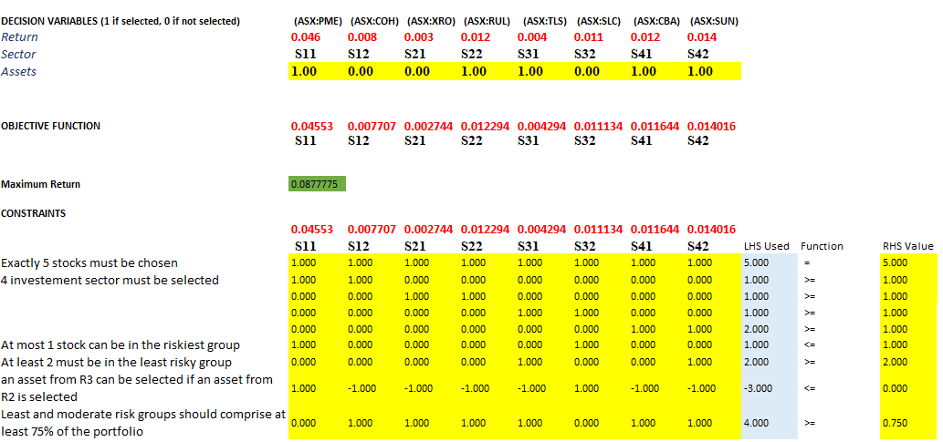
Optimal Solution

Slide 14
Interpretation and Suggestions
01
Interpretation
Maximum Return Achieved: 8.78%
Selected Stocks: PME, RUL, TLS, CBA, SUN
Sector Coverage: Technology, Industrials, Communications, Financials
Risk Allocation:
1 High-Risk (PME)
2 Moderate-Risk (RUL, CBA)
2 Least-Risk (TLS, SUN)
All constraints fully satisfied, ensuring:
Portfolio safety (≥75% low/moderate risk)
Diversification (4 unique sectors)
Risk control (max 1 high-risk stock)
Balanced portfolio with strong return and controlled exposure
02
Suggestions
Increase Asset Pool: More stock options could allow better returns while satisfying constraints.
Use Updated Market Data: Reflect recent stock performance for more accurate modeling.
Scenario Testing: Test alternative cases (e.g., 6 stocks, 2 high-risk) to analyze trade-offs.
Risk-Adjusted Optimization: Explore Sharpe ratio or mean-variance approaches for refined balancing.
Realistic Constraints: Consider adding transaction costs, liquidity, or dividend yields.
Compare with LP Model: Highlight differences in performance and allocation strategy.

Slide 15
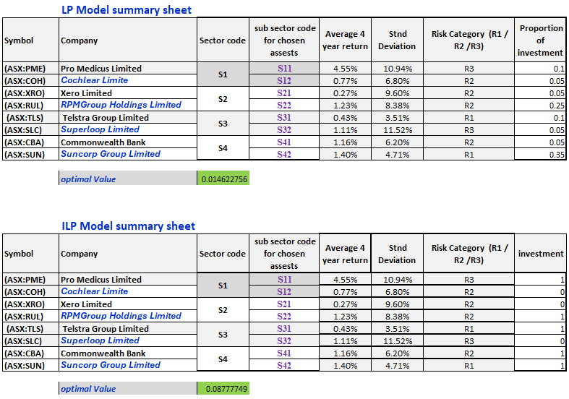
LP Vs. ILP Optimization Model Comparisons

Slide 16
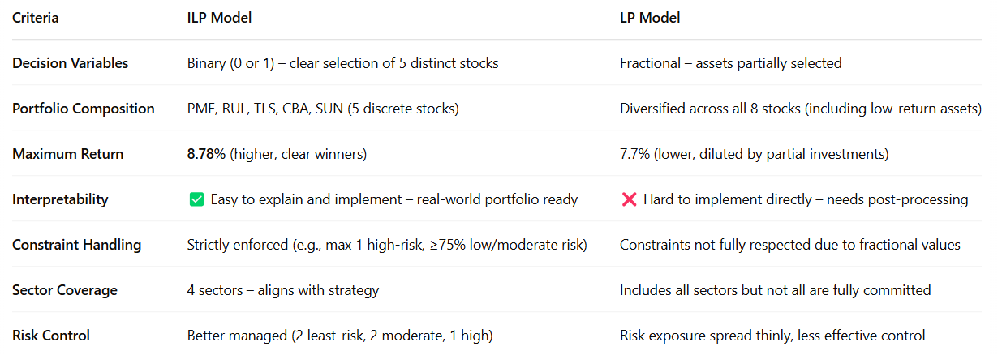
LP Vs. ILP Optimization Model Comparisons

Slide 17
Conclusion
LP Model: Provides flexibility in investment allocations but may result in unrealistic fractional stock investments. It offers a lower return compared to ILP.
ILP Model: Delivers higher returns by selecting whole stocks, adhering strictly to risk management constraints. It offers a more practical and realistic investment strategy.
Recommendation: The ILP model is preferable for realistic and higher-return strategies, while the LP model may be suitable for scenarios requiring more flexible asset distribution.

Slide 18
References
Listcorp. (2024). Australian Stock Exchange (ASX) Listed Companies - Listcorp. Www.listcorp.com. https://www.listcorp.com/asx/sectors/
‌
STOCKHISTORY function - Microsoft Support. (2020). Microsoft.com. https://support.microsoft.com/en-au/office/stockhistory-function-1ac8b5b3-5f62-4d94-8ab8-7504ec7239a8
‌
‌

